Slide 1
Machine Learning in Chemistry
Instructor: Prof. Tzuhsiung (Nick) Yang
Email: tyang@mx.nthu.edu.tw
Time: M5/6
Room: NTHU Library Comp Lab II
Notes:
Rafael Gomez

Slide 2
Fitting in chemistry

Slide 3
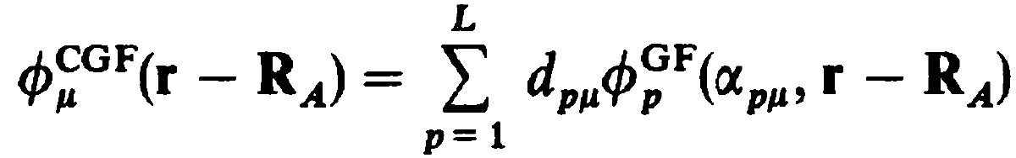
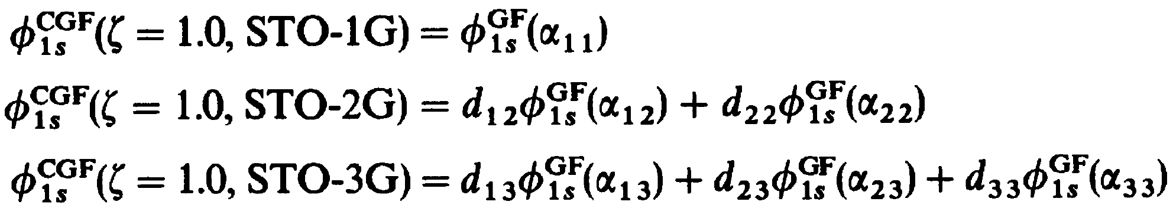
Basis sets
Since GTOs are easy to integrate yet have drawbacks, we can use linear combinations of GFs (primitives)
This is called basis set contraction and the contracted function is called a contracted Gaussian function (CGF) where L is called the length of contraction, d is called contraction coefficient, and ⍺ is called contraction exponent. We then fit these CGFs with length L (STO-LG) to STOs:
This contraction scheme for STO-3G is (3s)/[1s]

Slide 4
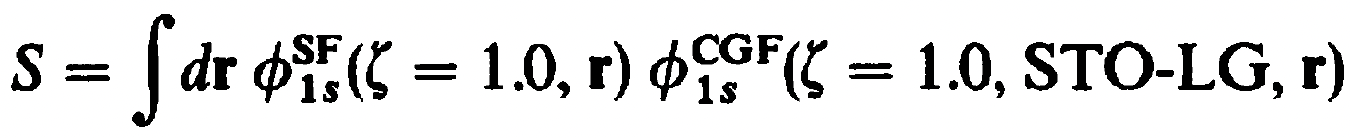
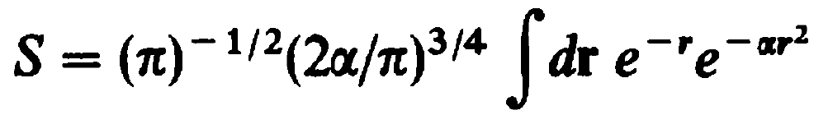
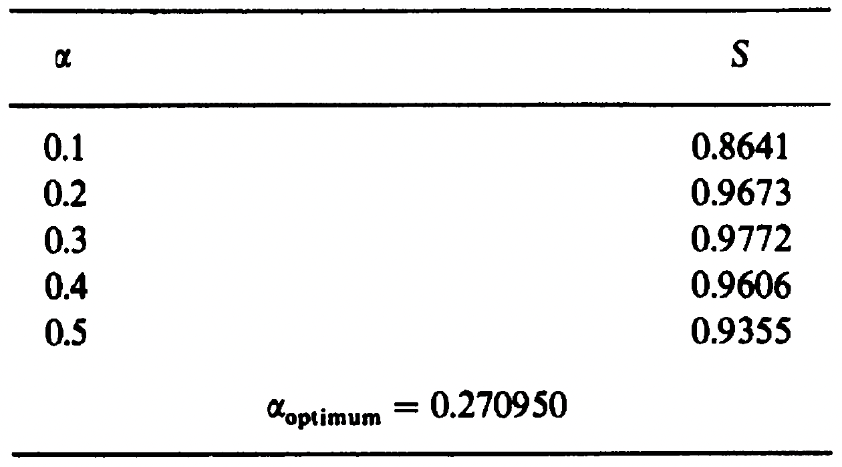
Basis sets
The fitting procedure minimizes
or equivalently, maximizes the overlap S since both functions are normalized.
For example, S for STO-1G is
and the corresponding optimal ⍺ is 0.270950

Slide 5
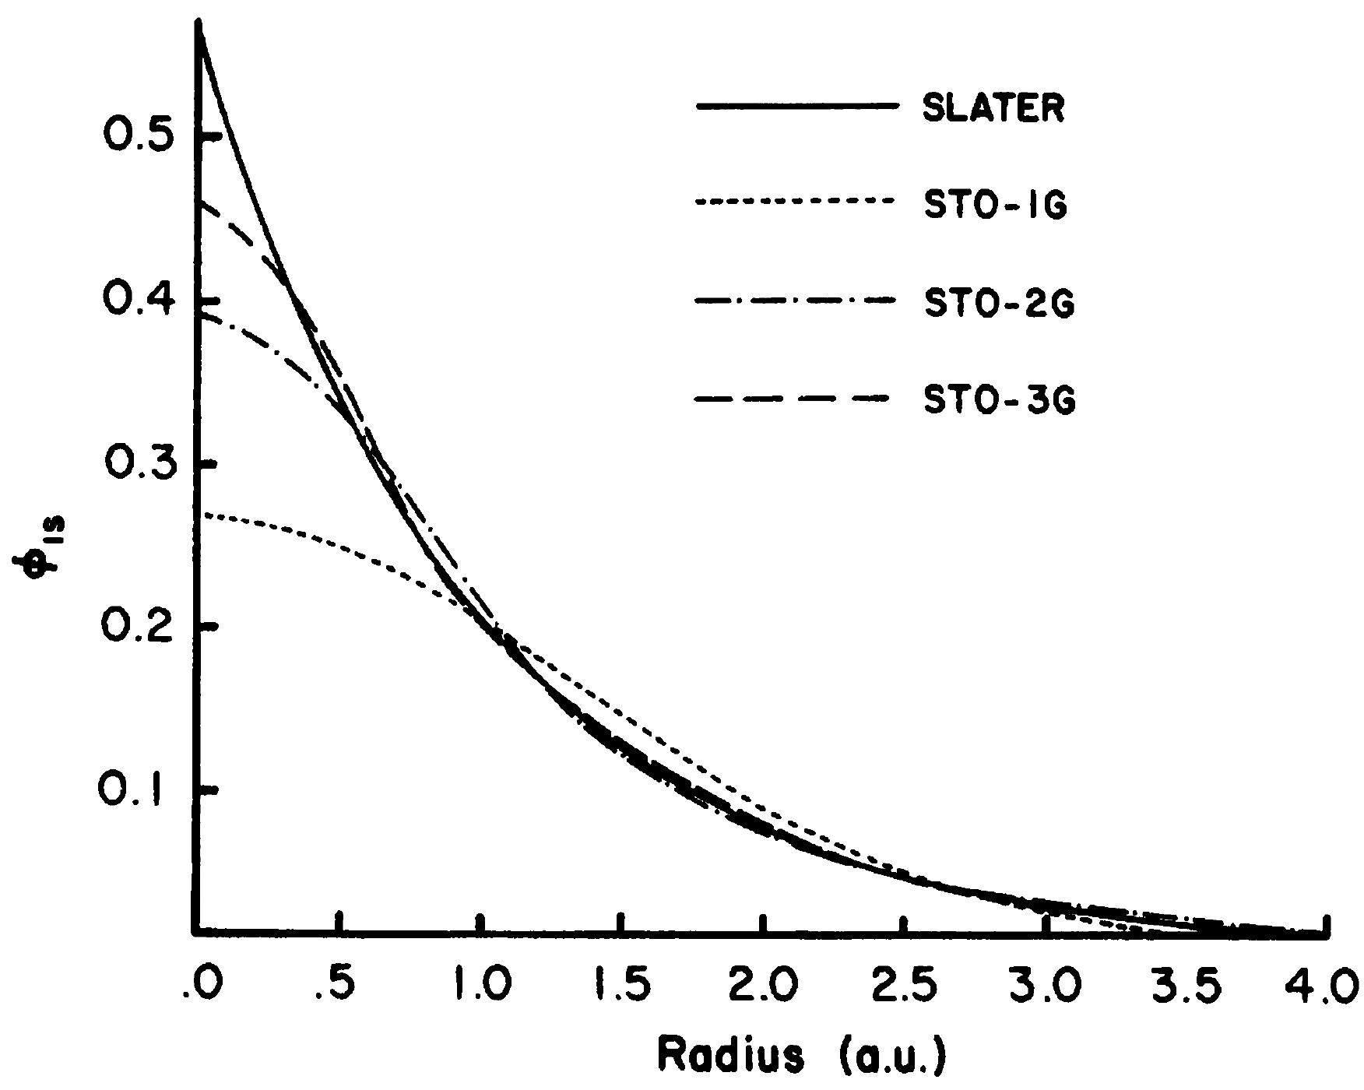
Basis sets

Slide 6
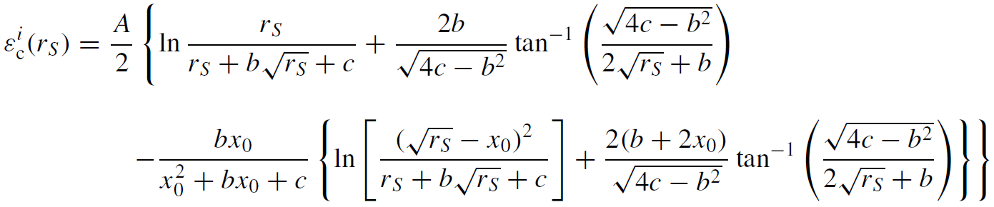
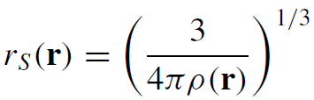
Functional form
Unfortunately, no analytical derivation has been found for the correlation energy density even for UEG. Hence, instead, Vosko, Wilk, and Nusair (VWN) proposed a local functionals that fit numerical results of simulations of correlations energies from quantum Monte Carlo techniques.
The constants A, x0, b, and c were fitted.

Slide 7
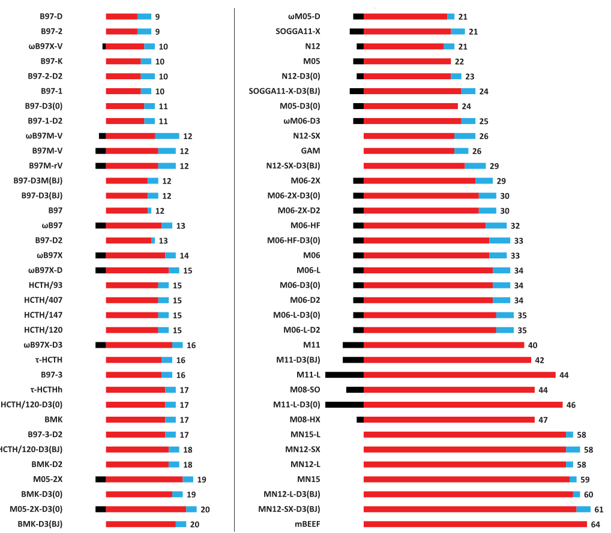
Is DFT non-empirical?

Slide 8
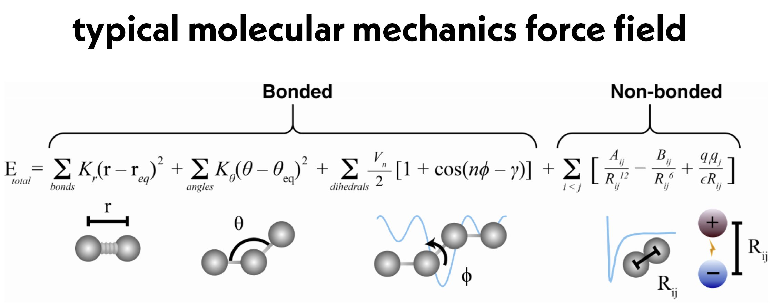
Force field
For the non-bonded term, there are two contributions
The nonbonded term is the most computationally intense term because the number of pairs drastically increases with distance (R³). Hence, cut-off distance is applied to limit the number of interactions.

Slide 9
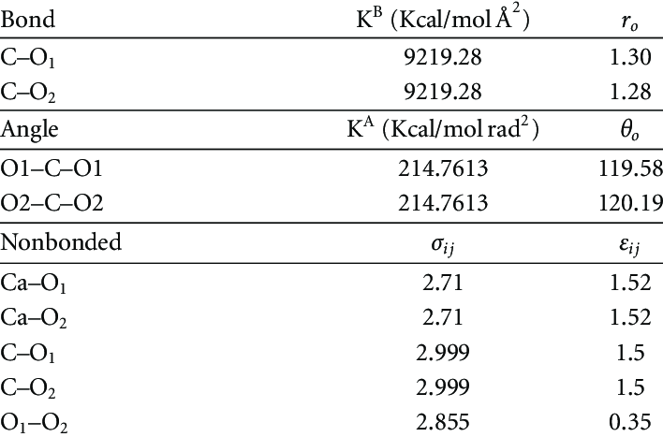
Forcefield parameters

Slide 10
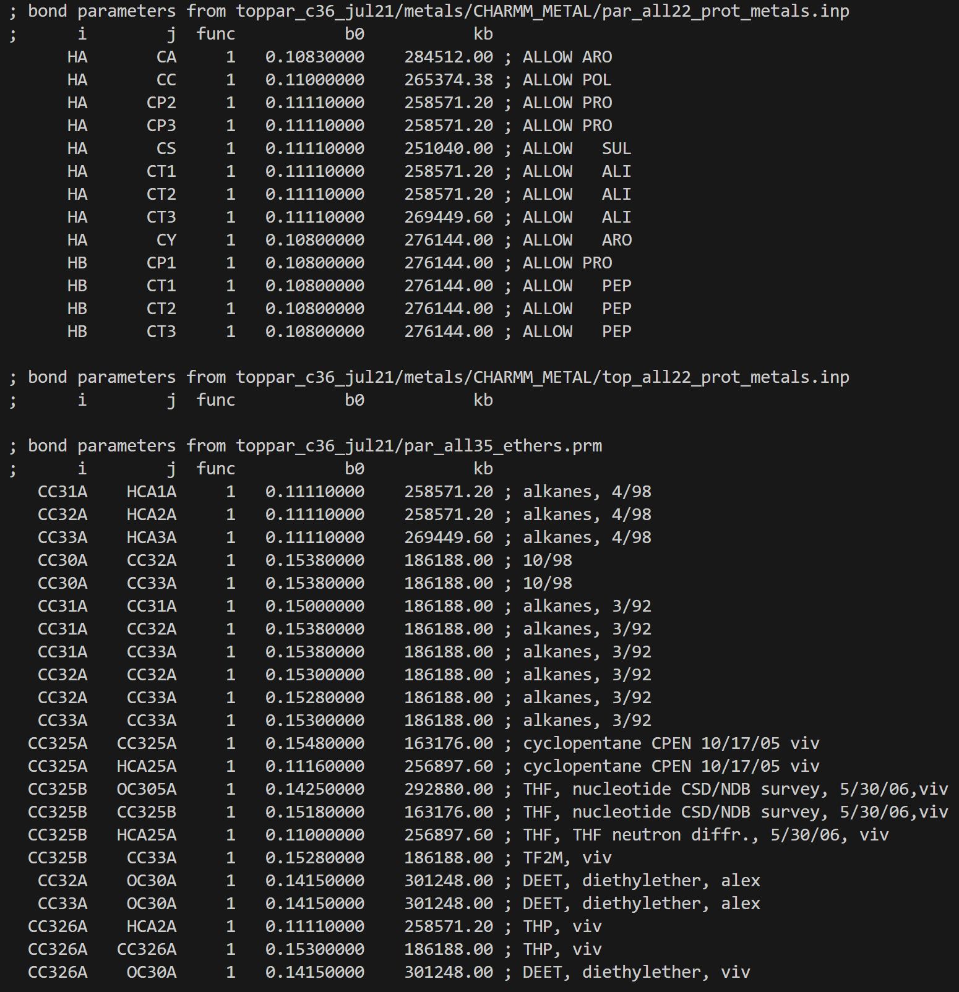
Forcefield parameters

Slide 11
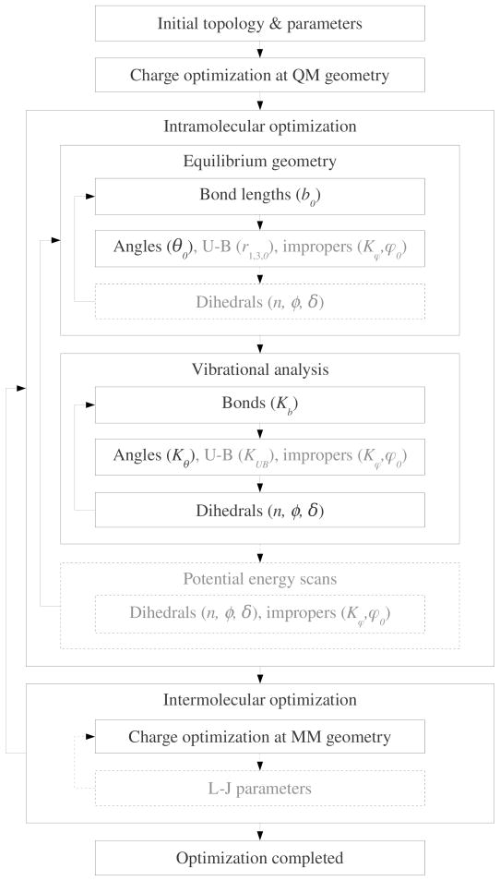
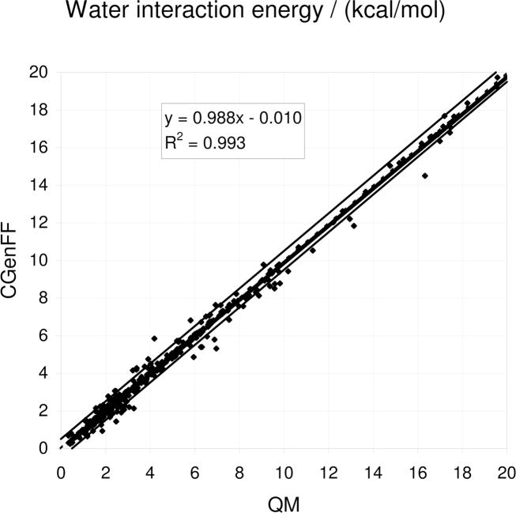
Forcefield parameters

Slide 12
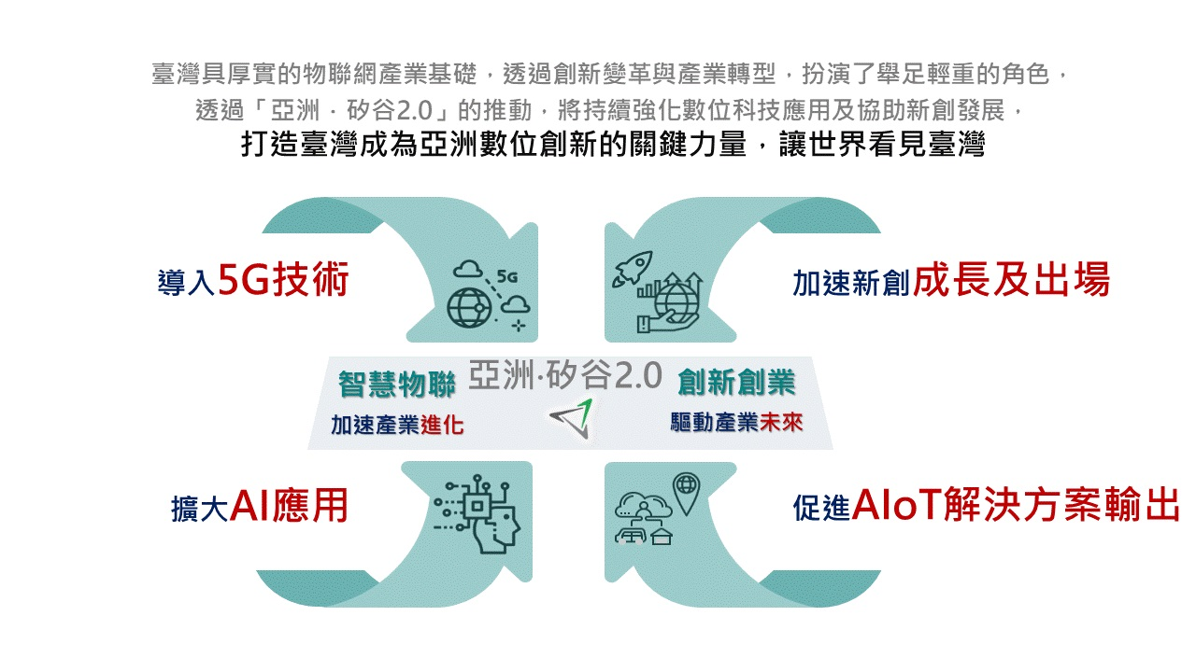
In Taiwan: Asia’s silicon valley 2.0
https://www.ey.gov.tw/achievement/F856D03EF813C8E7 Accessed on 2022/11/17

Slide 13
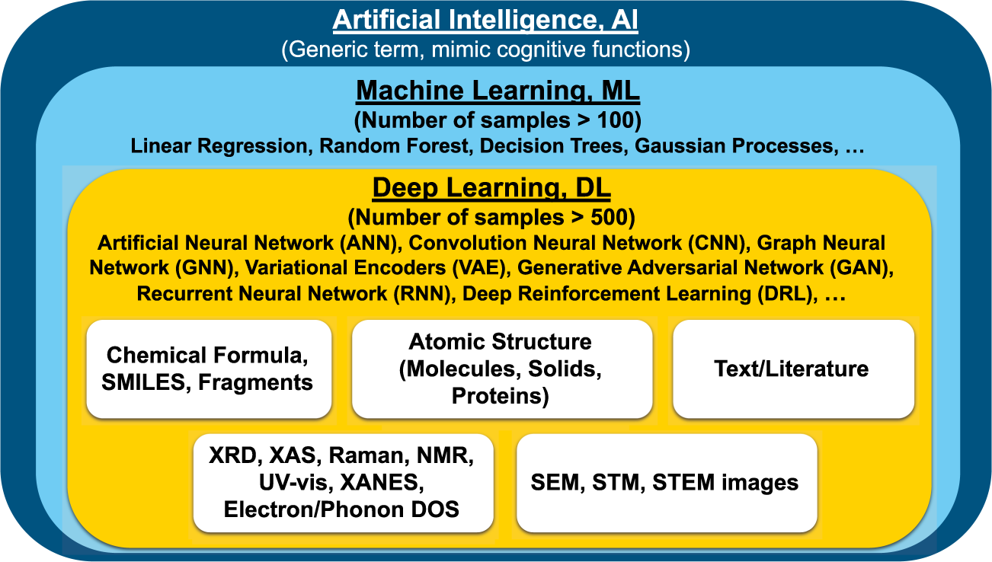
What is Machine Learning
Machine learning is a branch of artificial intelligence (AI) and computer science which focuses on the use of data and algorithms to imitate the way that humans learn, gradually improving its accuracy.
Machine learning is a crucial part of data science. It involves using algorithms and statistical methods to classify, predict, and discover insights in large datasets.
Choudhary, K., DeCost, B., Chen, C. et al. npj Comput Mater 8, 59 (2022)

Slide 14
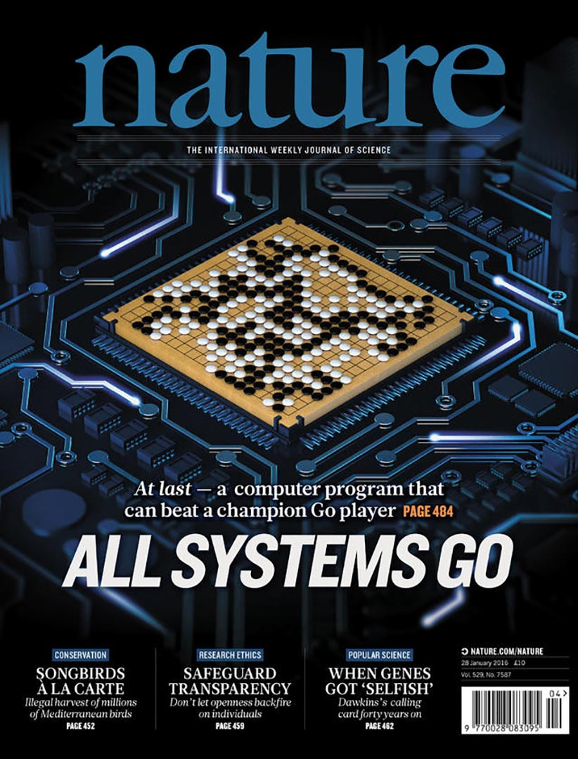
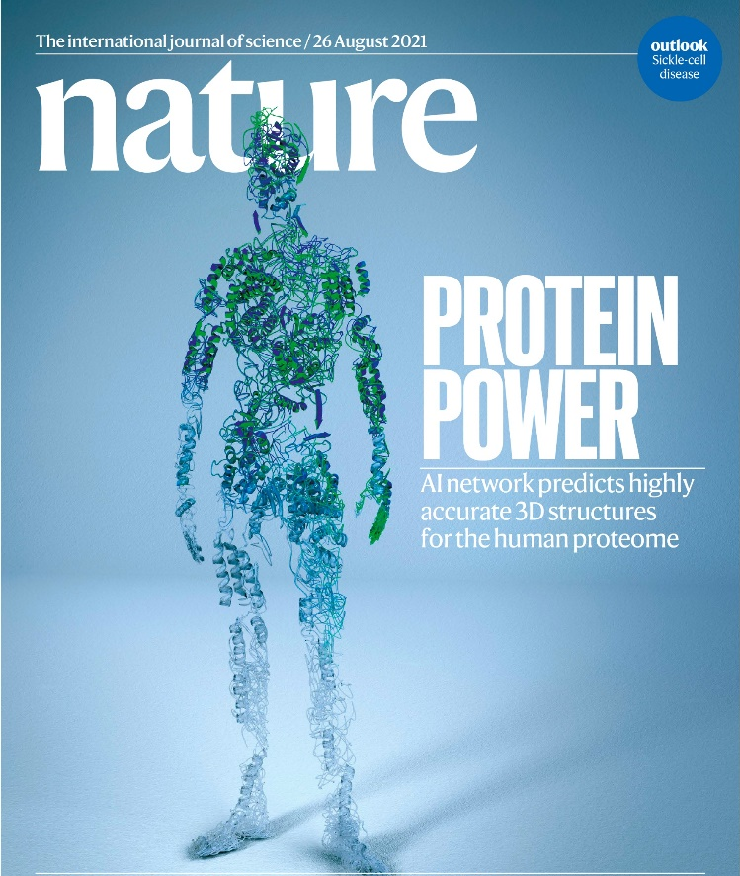
Applications of ML
Silver, D., Huang, A., Maddison, C. et al. Nature 529, 484–489 (2016)
Jumper, J., Evans, R., Pritzel, A. et al. Nature 596, 583–589 (2021)
Notes:
Two alpha that change the world
Alpha go prove that machine learning has it potential that can learning thing very fast , only 40 days, we can make a machine from zero to be a master of the game of go
One of the difficult chess in the world,
Furthermore , another application, Alpha fold2, published on nature ,which can successfully predict protein structure ,why we need to know structure? ,because the functionality of protein is determined by it’s structure

Slide 15
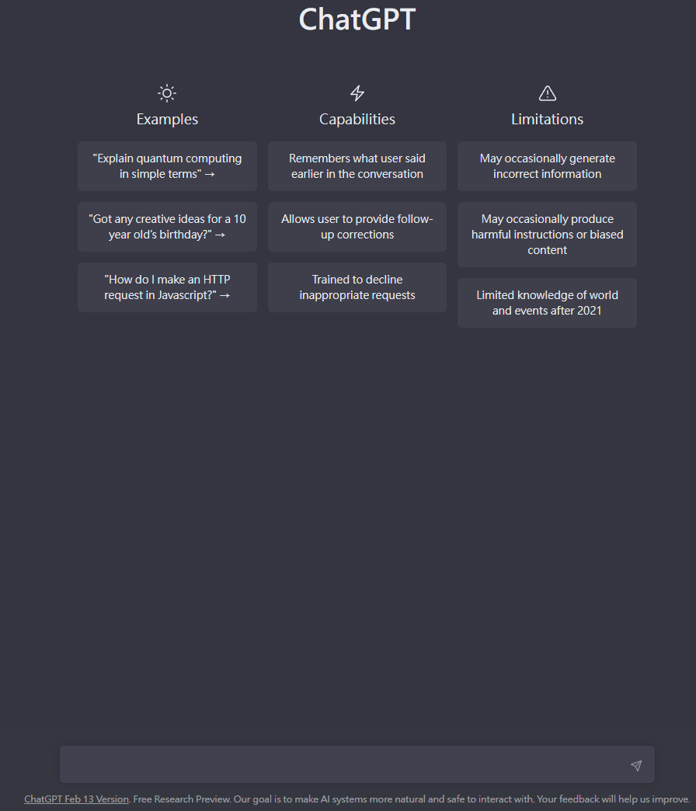

The latest big hit
Generative Pre-trained Transformer
https://chat.openai.com/chat accessed on 2023/03/01

Slide 16
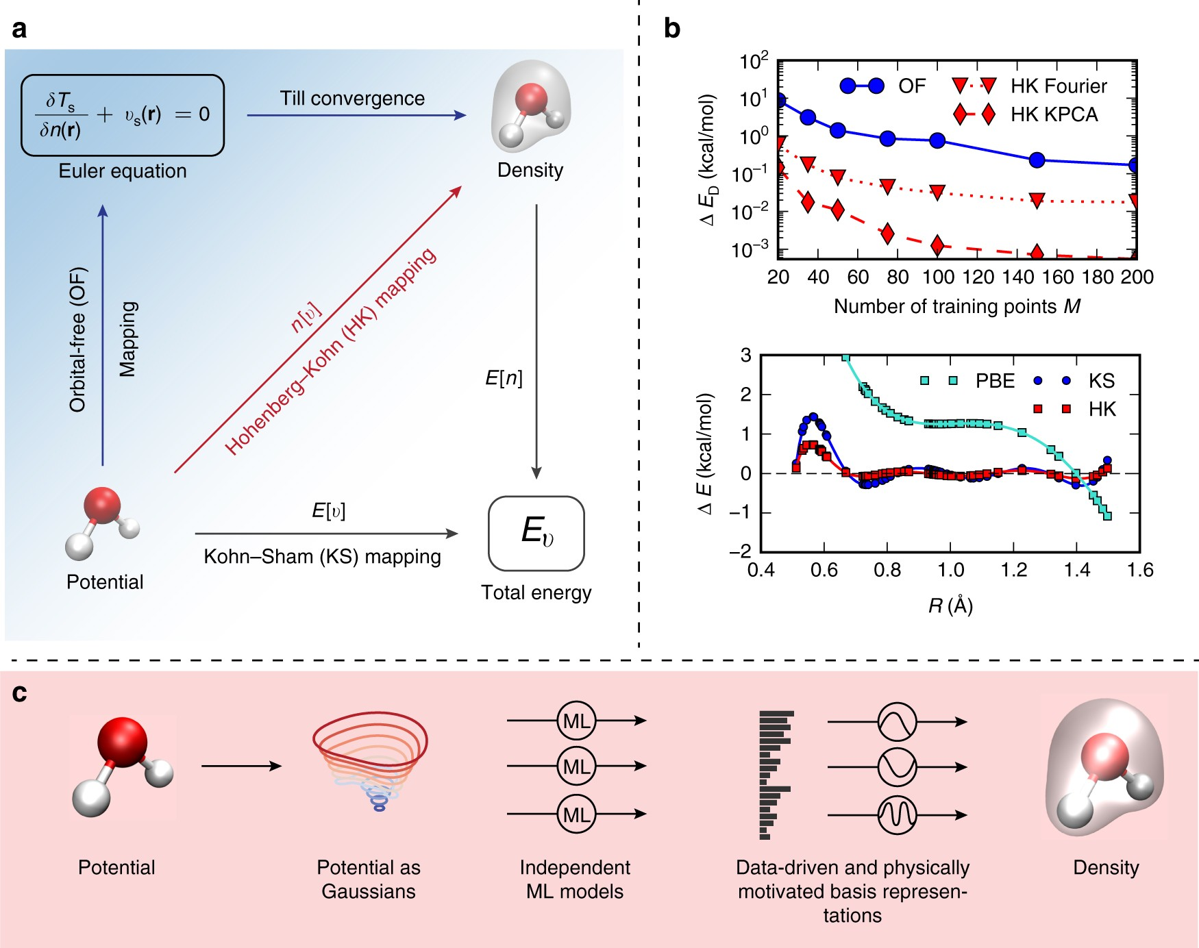
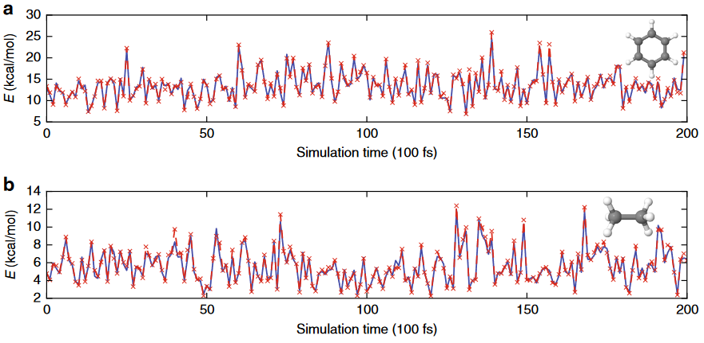
ML meets PhysChem
Brockherde, F.; Vogt, L.; Li, L.; Tuckerman, M. E.; Burke, K.; Müller, K.-R. Bypassing the Kohn-Sham Equations with Machine Learning. Nat Commun 2017, 8 (1), 872.

Slide 17
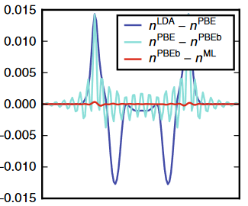
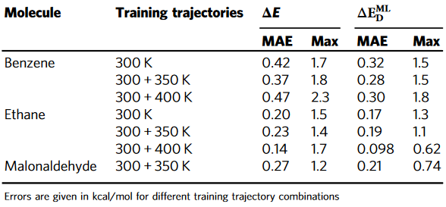
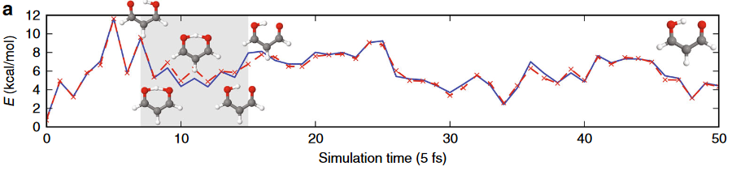
ML meets PhysChem
Brockherde, F.; Vogt, L.; Li, L.; Tuckerman, M. E.; Burke, K.; Müller, K.-R. Bypassing the Kohn-Sham Equations with Machine Learning. Nat Commun 2017, 8 (1), 872.

Slide 18
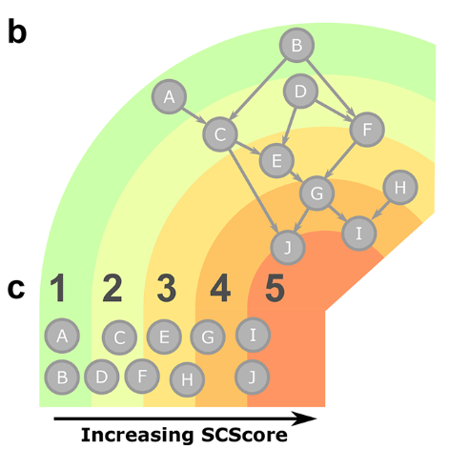
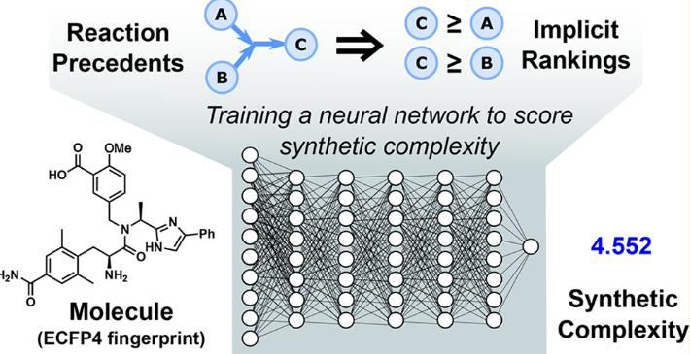
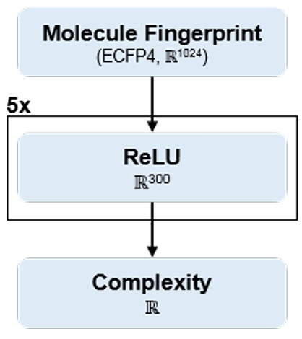

ML meets OrgChem
Coley, C. W.; Rogers, L.; Green, W. H.; Jensen, K. F. SCScore: Synthetic Complexity Learned from a Reaction Corpus. J. Chem. Inf. Model. 2018, 58, 252

Slide 19
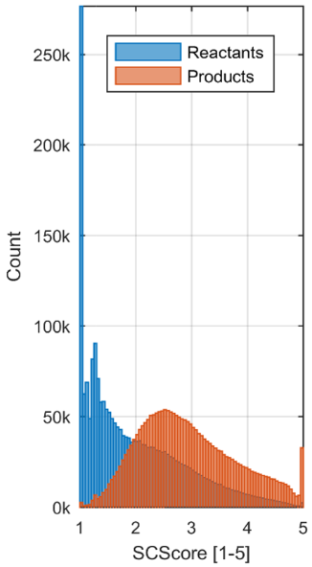
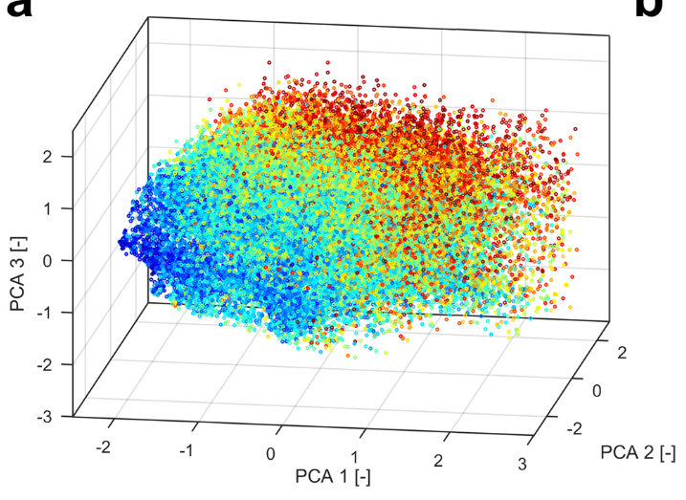
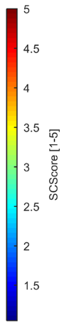
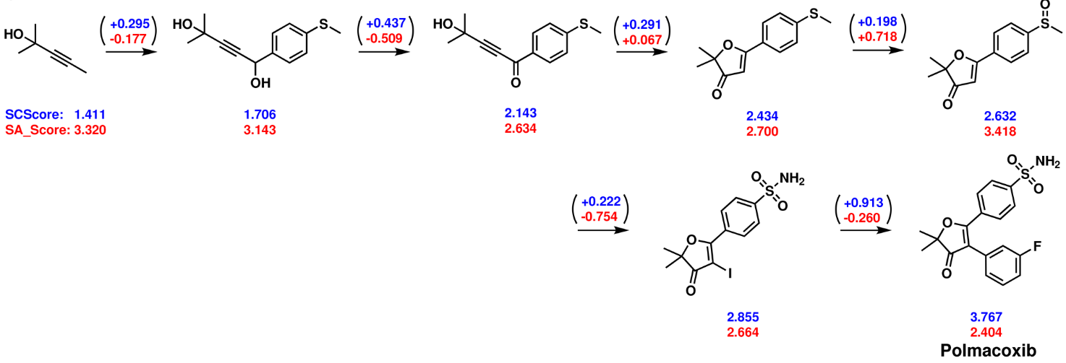
ML meets OrgChem
Coley, C. W.; Rogers, L.; Green, W. H.; Jensen, K. F. SCScore: Synthetic Complexity Learned from a Reaction Corpus. J. Chem. Inf. Model. 2018, 58, 252

Slide 20
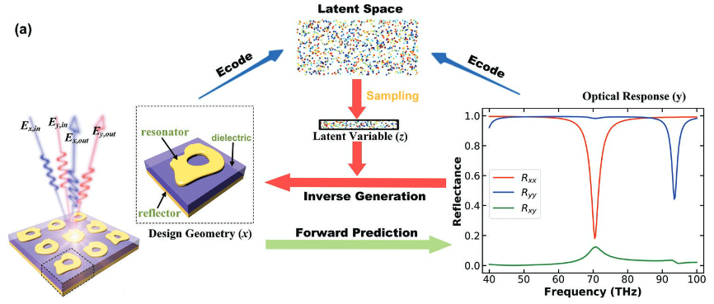
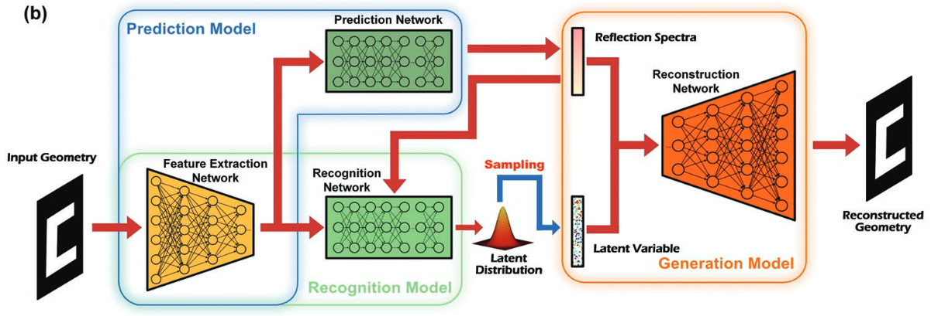
ML meets Materials
Ma, W.; Cheng, F.; Xu, Y.; Wen, Q.; Liu, Y.; Ma, W.; Xu, Y.; Wen, Q.; Liu, Y.; Cheng, F. Adv. Mater 2019, 31

Slide 21
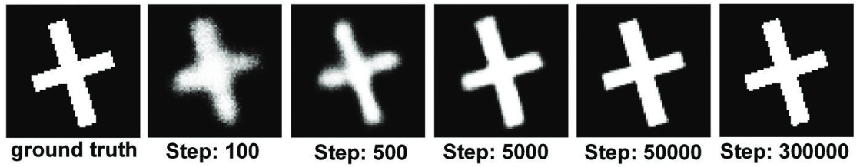
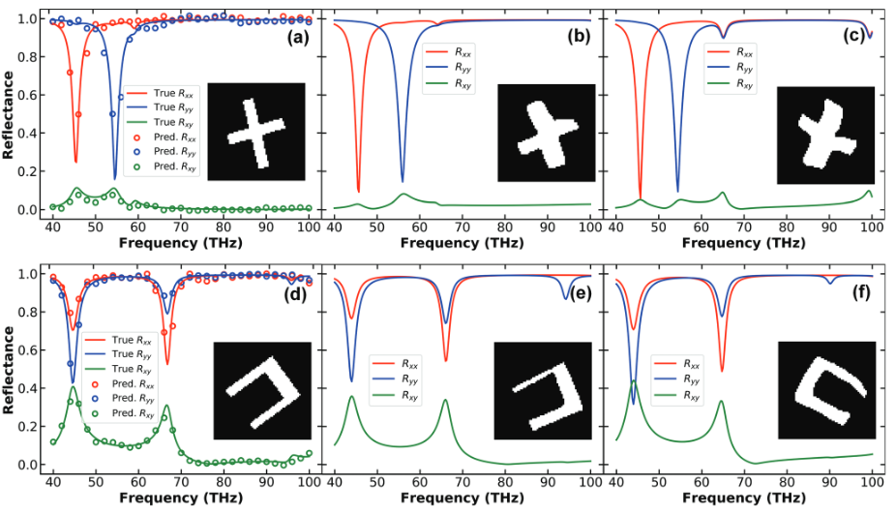
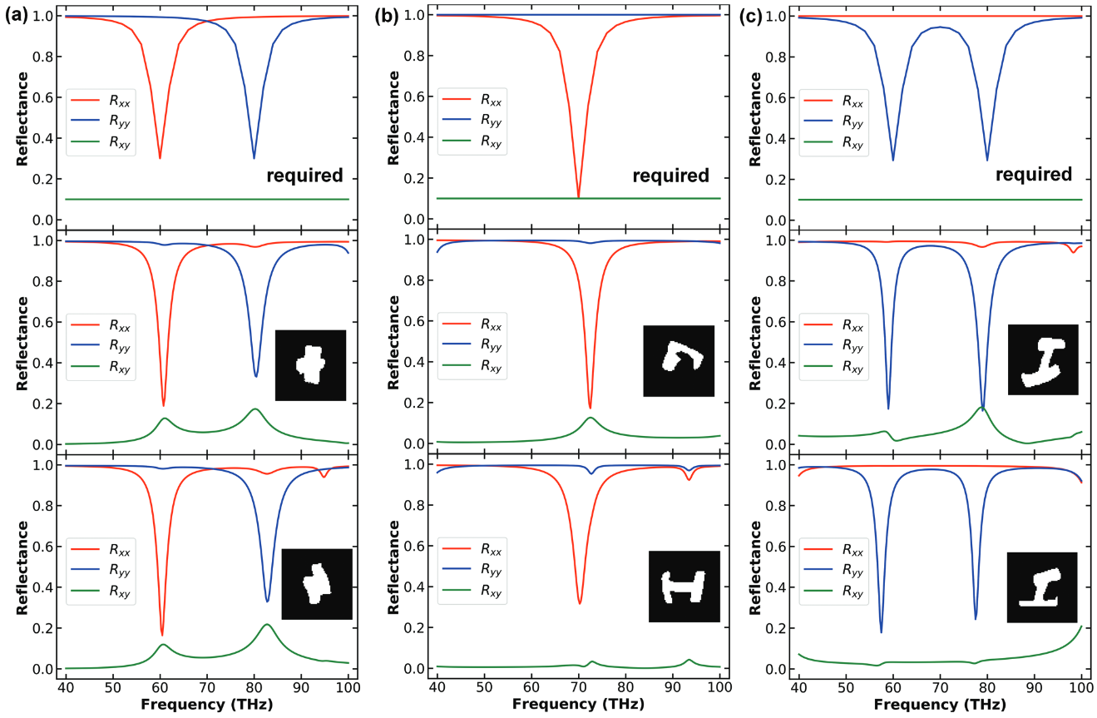
ML meets Materials
Given spectra, produce the expected geometry
For a desired spectra, produce new geometries
Ma, W.; Cheng, F.; Xu, Y.; Wen, Q.; Liu, Y.; Ma, W.; Xu, Y.; Wen, Q.; Liu, Y.; Cheng, F. Adv. Mater 2019, 31

Slide 22
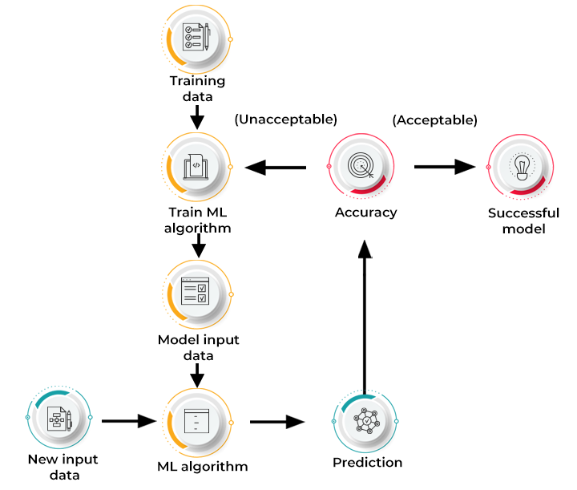
How does Machine Learning work?
https://www.spiceworks.com/tech/artificial-intelligence/articles/what-is-ml/

Slide 23
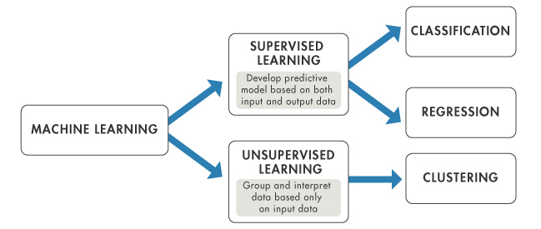
Type of Machine Learning Methods
Supervised Learning: Model learns from labeled training data to make predictions or classifications on unseen data. The goal is for the model to learn patterns and relationships in the training data, enabling it to generalize and make accurate predictions on new, unseen data.
Unsupervised learning: Model learns from unlabeled data without any predefined output labels. The goal of unsupervised learning is to discover patterns, structures, or relationships within the data.
Notes:
Overview of artificial intelligence (AI)

Slide 24

Classification vs. Regression
Classification: A process of finding a function which helps in dividing the dataset into classes In Classification, The task of the classification algorithm is to find the mapping function to map the input(x) to the discrete output(y).
Regression: A process of finding the correlations between dependent and independent variables. It helps in predicting the continuous variables.The task of the Regression algorithm is to find the mapping function to map the input variable(x) to the continuous output variable(y).

Slide 25
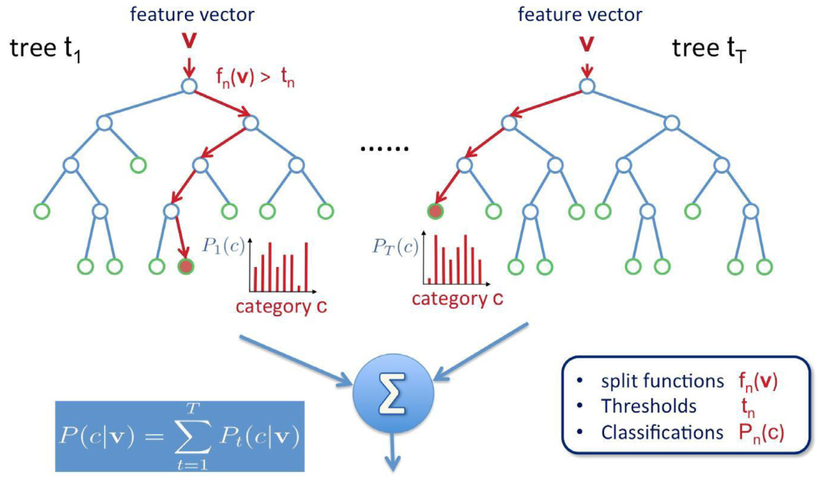
Random forest
Cano, G.; Garcia-Rodriguez, J.; Garcia-Garcia, A.; Perez-Sanchez, H.; Benediktsson, J. A.; Thapa, A.; Barr, A. Automatic Selection of Molecular Descriptors Using Random Forest: Application to Drug Discovery. Expert Systems with Applications 2017, 72, 151.

Slide 26
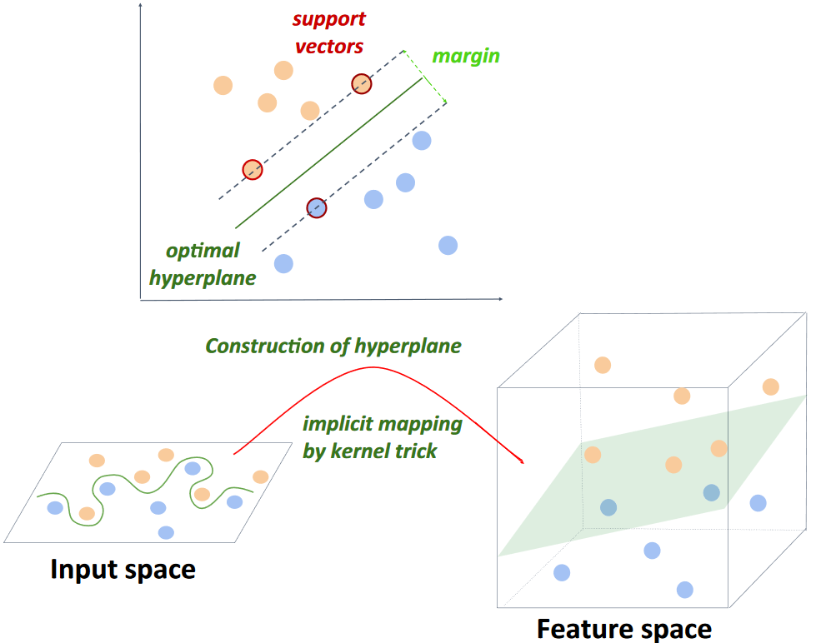
Support vector machine
Badillo, S.; Banfai, B.; Birzele, F.; Davydov, I. I.; Hutchinson, L.; Kam-Thong, T.; Siebourg-Polster, J.; Steiert, B.; Zhang, J. D. An Introduction to Machine Learning. Clinical Pharmacology & Therapeutics 2020, 107, 871

Slide 27
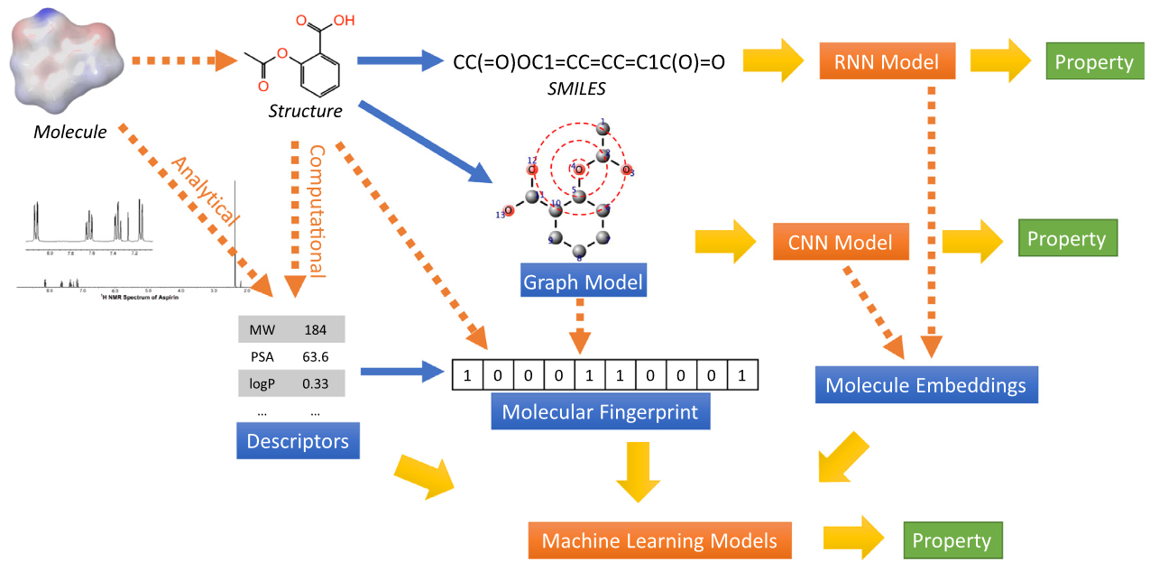
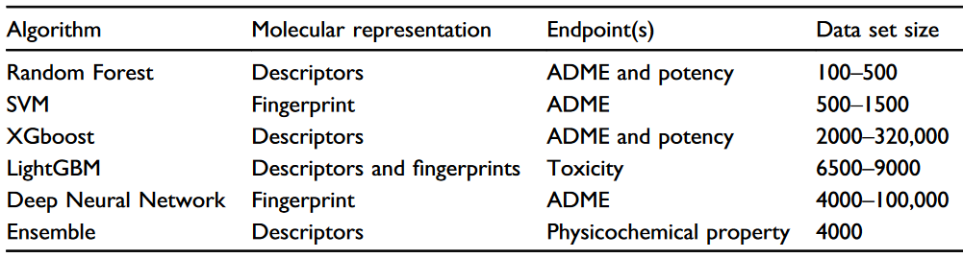
Machine learning
Choudhary, K.; DeCost, B.; Chen, C.; Jain, A.; Tavazza, F.; Cohn, R.; Park, C. W.; Choudhary, A.; Agrawal, A.; Billinge, S. J. L.; Holm, E.; Ong, S. P.; Wolverton, C. Recent Advances and Applications of Deep Learning Methods in Materials Science. npj Comput Mater 2022, 8 (1), 1

Slide 28
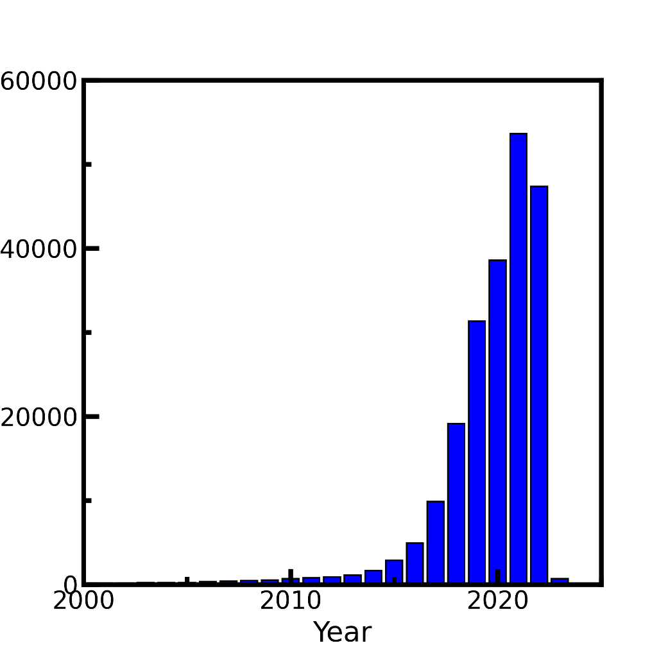


Game changed in 2009
#Publication mentioning deep learning
CUDA introduced in 2007
Publication counts: Web of science, keyword=‘Deep learning’. Accessed on 2022/11/22

Slide 29





Deep Learning Framework

Slide 30
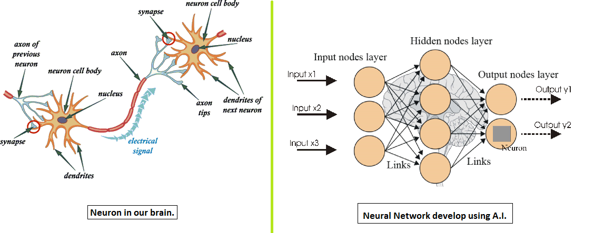
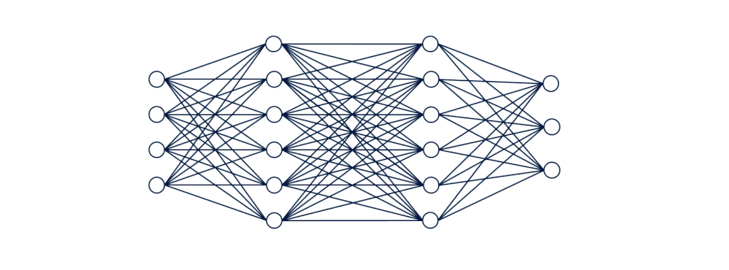
Artificial Neural Network (ANN)

Slide 31
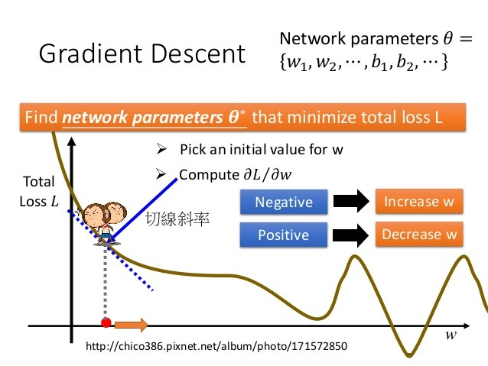

Gradient descent
Gradient descent is an optimization algorithm used in machine learning to minimize the loss or error of a model. It iteratively adjusts the model's parameters by taking steps proportional to the negative gradient of the loss function. It aims to find the optimal values that minimize the error and improve model performance.
slope

Slide 32
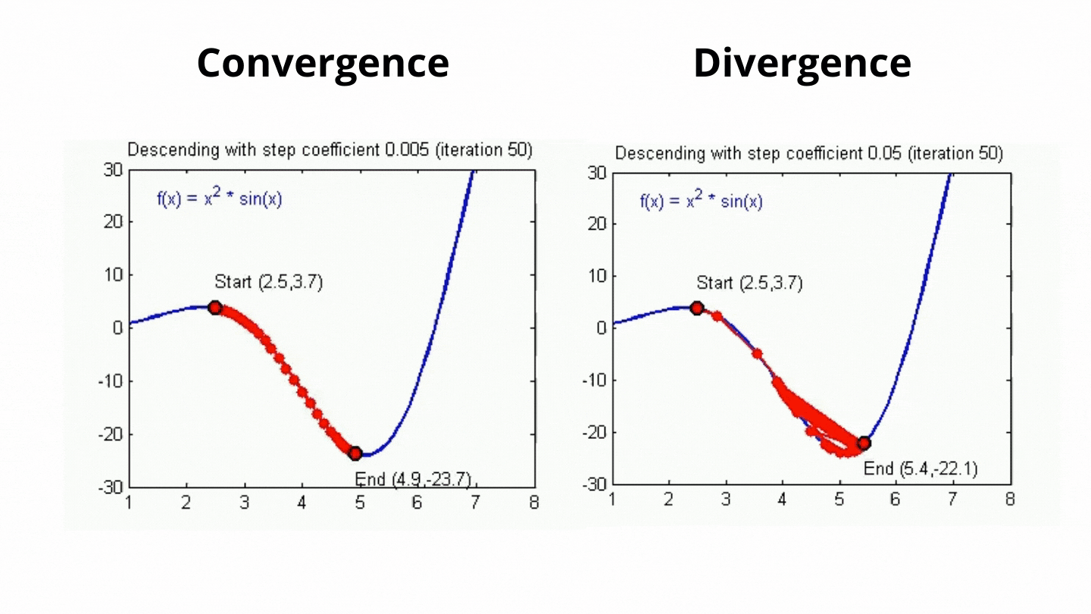
Learning Rate
Learning rate controls how much the parameters are adjusted based on the gradients of the loss function.
https://towardsai.net/

Slide 33
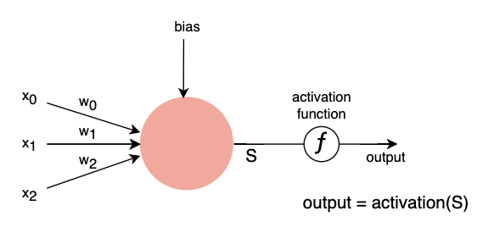
Activation Function
Activation functions are important in machine learning because they introduce nonlinearity, allowing models to learn complex patterns and make non-linear predictions. They also help propagate gradients during training and control the output range of the model for better interpretation and performance.

Slide 34

Activation Functions

Slide 35
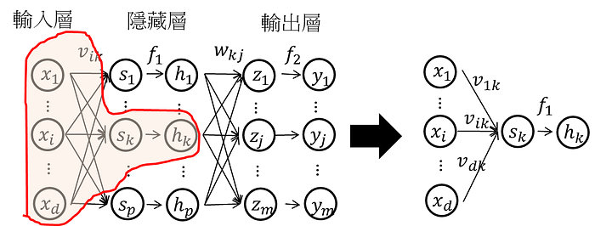
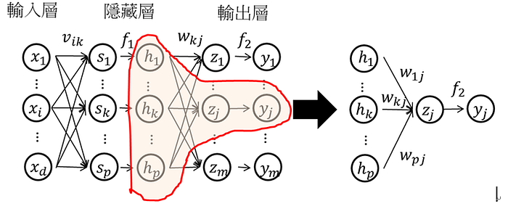




Forward Propagation
Through activation function
Output =

Slide 36



Backward Propagation
Notes:
loss function: L(θ) 等於所有的training data的loss總和
Forward pass 每一個neuron 的activation function 的output，就是他所連結的weight 的 ∂z/∂w
Backward pass 建一個與原來方向相反的neural network，它的三角形neuron的output 就是 ∂l/∂z，把通過forward pass 得到的 ∂z/∂w 和通過backward pass 得到的 ∂l/∂z 乘起來就可以得到 l 對 w 的偏微分 ∂l/∂w

Slide 37

Recurrent Neural Network (RNN)
RNN : Mostly used in language model, speech recognition, RNNs have feedback connections, which allow them to maintain an internal memory of past computations, making them capable of handling sequences of arbitrary length

Slide 38

Convolutional Neural Network(CNN)
CNN : Used in image classification, object detection. It utilizes convolutional layers, which apply filters to input data to extract relevant features. By using shared weights and pooling operations, CNNs can capture spatial hierarchies and learn patterns at different scales

Slide 39

ML in Chemistry
Predict from X-ray::Suzuki, Y. et al. Sci. Rep. 10, 21790 (2020)
Predict from electronic density of states: Fung, V., Hu, G., Ganesh, P. & Sumpter, B. G.Nat. Commun. 12, 88 (2021)
Notes:
Choudhary, K., DeCost, B., Chen, C. et al. npj Comput Mater 8, 59 (2022).

Slide 40



ML in Chemistry
VAE in chemistry: Gomez-Bombarelli, R.; Aspuru-Guzik, A.; and coworkers. ACS Cent. Sci. 2018, 4, 268
Notes:
VAE里面z到x的depencence是随机的，而GAN里是确定性的。这使得VAE的inference相对来说是well-defined的而GAN的inferernce相对来说是病态的。
这个建模上的区别也是来自于两者建模目的的不同。GAN就是为了生成新图片，而VAE除此之外，更想做的事情是建模数据的分布以及学到数据的隐含表示

Slide 41

What is SMILES?
SMILES (Simplified Molecular Input Line Entry System) A chemical notation that allows a user to represent a chemical structure in a way that can be used by the computer.

Slide 42


Molecular Fingerprint
Molecule fingerprints are binary bit strings that represent the structural features of a molecule. Uses a circular neighborhood around each atom in a molecule to capture local structural information.

Slide 43

Interactive
Login to ${USER}@ln01.twnia2.twcc.aii
Go to exercise1
Click smi.ipynb
Run kernel
We can used python package easily show smile string to molecules

Slide 44

Interactive
1.Click smi_inform_retriver.ipynb
2.Run kernel
3.Used smi_infrom_retrivert to obtain logP, TPSA
Work Flow

Slide 45

What is logp and TPSA
1.LogP (Partition Coefficient): LogP stands for logarithm of the partition coefficient. It is a measure of the lipophilicity or hydrophobicity of a molecule. LogP indicates how a molecule partitions between a nonpolar solvent (usually octanol) and water.
2.TPSA (Topological Polar Surface Area): TPSA represents the total polar surface area of a molecule. It is a measure of the surface area of a molecule that is involved in polar interactions, such as hydrogen bonding and dipole-dipole interactions. TPSA is calculated by summing up the contributions of individual polar atoms and functional groups in the molecule.

Slide 46

Interactive
1.Go to Exercise 2
2.Sbatch submit_training.sh
3.Training a model to predict molecules property

Slide 47

Details about training model
Dataset size = Iteration * Batch size （1 Epoch）Iteration = （Data set size / Batch size）* Epoch

Slide 48


How batch size effect gradient descent
Batch size = 10
Batch size = 1
https://medium.com

Slide 49

Is larger batch size always perform well?
Large batch size Advantages : provide smoother and more stable gradients, which can facilitate convergence. Large batch size
Disadvantages: Reduce the randomness in each iteration during training, which can affect the model's generalization ability.

Slide 50


Loss Function
For regression case
For classification case

Slide 51


Parity plot
A parity plot is a scatterplot that compares a set of results from a training model against ground truth data. Each point has coordinates (x, y), where x is a true value and y is the corresponding value from the model.

Slide 52
Interactive
Go to Exercise 3
Click parity_plot.ipynb
Run kernel
Shown the parity of model prediction with ground truth
Analyzed the rmse loss and mae loss of model performance

Slide 53

Generative models
Sanchez-Lengeling, B.; Aspuru-Guzik, A. Inverse Molecular Design Using Machine Learning: Generative Models for Matter Engineering. Science 2018, 361, 360

Slide 54

Generative models
Sanchez-Lengeling, B.; Aspuru-Guzik, A. Inverse Molecular Design Using Machine Learning: Generative Models for Matter Engineering. Science 2018, 361, 360

Slide 55

Generative models
Bilodeau, C.; Jin, W.; Jaakkola, T.; Barzilay, R.; Jensen, K. F.; Klavs Jensen, C. F. Generative Models for Molecular Discovery: Recent Advances and ChallengesMachine Learning. 2022.

Slide 56

Generative Adversarial Networks (GAN)
Goodfellow, I. J.; Pouget-Abadie, J.; Mirza, M.; Xu, B.; Warde-Farley, D.; Ozair, S.; Courville, A.; Bengio, Y. Generative Adversarial Networks. arXiv June 10, 2014. https://doi.org/10.48550/arXiv.1406.2661.

Slide 57




Generative Adversarial Network (GAN)
Goodfellow, I. J.; Pouget-Abadie, J.; Mirza, M.; Xu, B.; Warde-Farley, D.; Ozair, S.; Courville, A.; Bengio, Y. Generative Adversarial Networks. arXiv June 10, 2014. https://doi.org/10.48550/arXiv.1406.2661.

Slide 58



Generative Adversarial Network (GAN)
Goodfellow, I.; Pouget-Abadie, J.; Mirza, M.; Xu, B.; Warde-Farley, D.; Ozair, S.; Courville, A.; Bengio, Y. Generative Adversarial Networks. Commun. ACM 2020, 63, 139

Slide 59

Generative Adversarial Network (GAN)
GAN : The core idea of a GAN is based on the "indirect" training through the discriminator, another neural network that can tell how "realistic" the input seems, which itself is also being updated dynamically. GANs are used for generating synthetic data that resembles a specific input dataset

Slide 60

Objective-Reinforced Generative Adversarial Networks (ORGAN)
Gθ is a RNN with LSTM cells trained on ZINC database
Dφ is Convolutional Neural Network (CNN) for text classification tasks
Guimaraes, G. L.; Sanchez-Lengeling, B.; Outeiral, C.; Farias, P. L. C.; Aspuru-Guzik, A. Objective-Reinforced Generative Adversarial Networks (ORGAN) for Sequence Generation Models. arXiv February 6, 2018. https://doi.org/10.48550/arXiv.1705.10843.

Slide 61



GAN for molecule design
N = 5440
N = 5000
Guimaraes, G. L.; Sanchez-Lengeling, B.; Outeiral, C.; Farias, P. L. C.; Aspuru-Guzik, A. Objective-Reinforced Generative Adversarial Networks (ORGAN) for Sequence Generation Models. arXiv February 6, 2018. https://doi.org/10.48550/arXiv.1705.10843.
Notes:
W = the Wasserstein variant

Slide 62



GAN for generating crystal structure
Kim, S.; Noh, J.; Gu, G. H.; Aspuru-Guzik, A.; Jung, Y. Generative Adversarial Networks for Crystal Structure Prediction. ACS Cent. Sci. 2020, 6, 1412

Slide 63

Variational Autoencoder

Slide 64



VAE for molecule design
Gómez-Bombarelli, R.; Wei, J. N.; Duvenaud, D.; Hernández-Lobato, J. M.; Sánchez-Lengeling, B.; Sheberla, D.; Aguilera-Iparraguirre, J.; Hirzel, T. D.; Adams, R. P.; Aspuru-Guzik, A. Automatic Chemical Design Using a Data-Driven Continuous Representation of Molecules. ACS Cent. Sci. 2018, 4, 268

Slide 65





VAE for molecule design
Jin, W.; Barzilay, R.; Jaakkola, T. Junction Tree Variational Autoencoder for Molecular Graph Generation. arXiv March 29, 2019. https://doi.org/10.48550/arXiv.1802.04364.

Slide 66

Interactive
Go to Exercise 4
Click Generatesample.ipynb
Run kernel
Assign a smiles string that model can generate similar molecule
Run kernel
Model generate nearby molecule

